Slide 1
NovaKart – Customer Insights & Revenue Performance Analysis
- A Case Study by Anik Chakraborty

Slide 2
🎯 Objective
Analyze and interpret Novakart’s customers, products & purchases data to uncover actionable insights that drive user engagement, product optimization, targeted marketing, inventory planning, and regional focus.
Project Purpose:
To analyze customer behavior, revenue, and profit trends for NovaKart, an e-commerce retail dataset
To identify high-performing customer segments, geographies, products and time periods
To convert raw transactional data into actionable business insights
Key KPIs:
Total Customers: 997
Total Revenue: 2.96M
Total Profit: 3.29M
Average Profit Margin (%): 80.42
Deliverables:
Interactive Power BI dashboard
Exploratory & analytical Python (Jupyter) notebook
Insight-driven business recommendations

Slide 3
📘 Project Overview
Context Highlights:
The analysis helps NovaKart’s marketing, R&D, and product teams understand:
NovaKart operates across multiple states and cities
Customers purchase products from different companies and categories
Dataset captures demographics, geography, revenue, profit, and time-based attributes
Goal was to replicate Power BI insights using Python for analytical consistency

Slide 4
🗂️ Data Overview & Schema
Data Source:
Source: Simulated retail transactional dataset for customer, product & revenue analytics
Data Type: Structured transactional and customer-level sales data
Time Period: Multi-month transactional snapshot (aggregated for trend analysis)
Data Structure & Metrics:
Key Index Types: Customer , Product & Purchase level records
Total Rows: Customers - ~1000
Categories:
Customer Details: customer_id, full_name, gender, city, state
Product Details: product_id, product, company, product_qty
Time Attributes: purchase_date, month, day
Financial Metrics: revenue, profit, profit_margin
Calculated Metrics:
Revenue & profit contribution
Profit margin (%)
Customer & city-level aggregation KPIs
Time-based performance indicators (monthly & weekday trends)

Slide 5
💻 Tech Stack
Tools:
Excel / CSV
Data storage & preprocessing
Python
Pandas, NumPy, Matplotlib, Seaborn
Jupyter Notebook
Data cleaning, EDA & visual analysis
PowerQuery
ETL transformations
PowerBI
Visualization, DAX measures & dashboard design
DAX – Calculated measures and time intelligence
PowerPoint
Presentation and final dashboard snapshots

Slide 6
📈 Methodology & Analysis
Preparation, Process & Analytical Approach:
Data Preparation & Cleaning:
Removed invalid and "N/A" category values
Standardized categorical fields (Gender, City, State, Month)
Verified data consistency between Python & Power BI outputs
Data Modeling & Integration:
Combined customer, product, and transaction tables into a unified dataset
Established relationships for customer, geography, and time dimensions
Feature Engineering:
Created derived columns for month & weekday analysis
Computed profit margins and revenue contribution metrics
Aggregated KPIs at customer, city, state, and product levels
Visualization Design:
Built two interactive dashboards:
Customer & Location Insights
Product & Company Insights
Integrated interactive slicers for dynamic segmentation
Validation & Formatting:
Cross-validated Python visuals with Power BI outputs
Ensured sorting, ordering (months, cities), and KPI consistency

Slide 7
❓ Problem Statement
Retail businesses generate large volumes of transactional data across customers, products, locations, and time, yet actionable insights are often difficult to extract without structured analysis.
This project analyzes customer-level sales data to understand purchasing behavior, geographic performance, and profitability drivers, enabling stakeholders to identify high-value customers, top-performing regions, and opportunities to improve revenue and profit margins.
Key Questions:
Which customer segments generate the highest revenue and profit?
Which states and cities contribute most to business performance?
How does gender impact revenue and profit trends?
What are the top-performing products and companies?
Which months and weekdays drive maximum sales?
Where are profit margins the strongest geographically?

Slide 8
💡 Key Insights
Top Findings:
Male customers slightly outperform females in total revenue & profit.
Texas and California are top revenue-generating states.
Washington and El Paso lead in customer concentration.
A small group of customers contributes disproportionately to revenue.
Certain products and companies dominate overall sales.
Revenue peaks during specific months, showing seasonal trends.
Supporting Metrics:
Total Customers: ~1000
Total Revenue: ~3.29M
Total Profit: ~2.96M
Average Profit Margin: ~80%

Slide 9
📍Conclusion
Summary:
NovaKart’s performance is driven by specific customer segments, cities, and products.
Geographic and demographic analysis reveals clear revenue concentration.
Python and Power BI results are aligned and consistent.
Insights can guide targeted marketing, inventory planning, and regional focus.

Slide 10
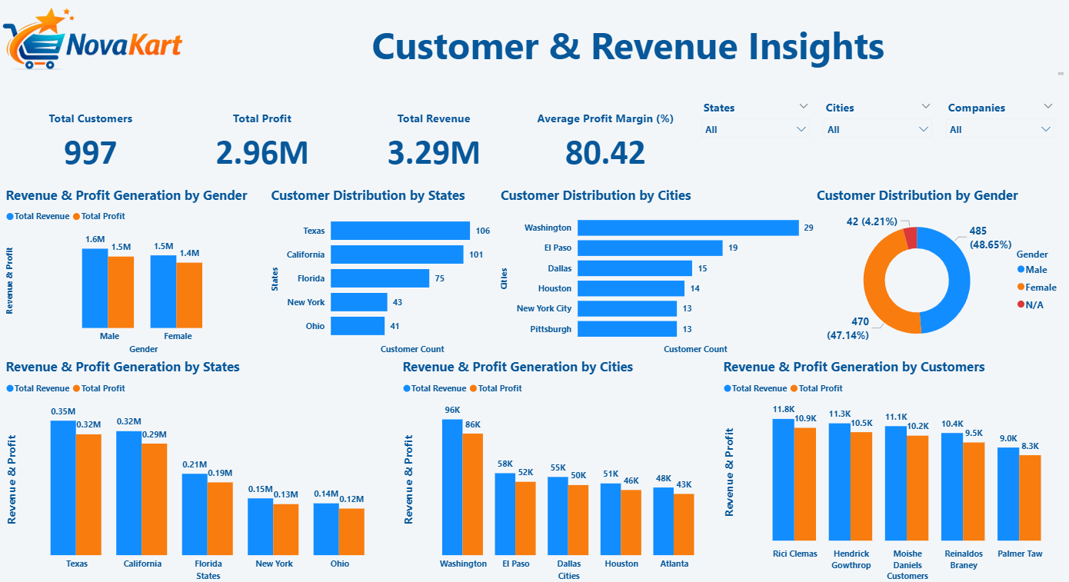
🖥️ Dashboard Overview (1) – Customer & Location Insights

Slide 11
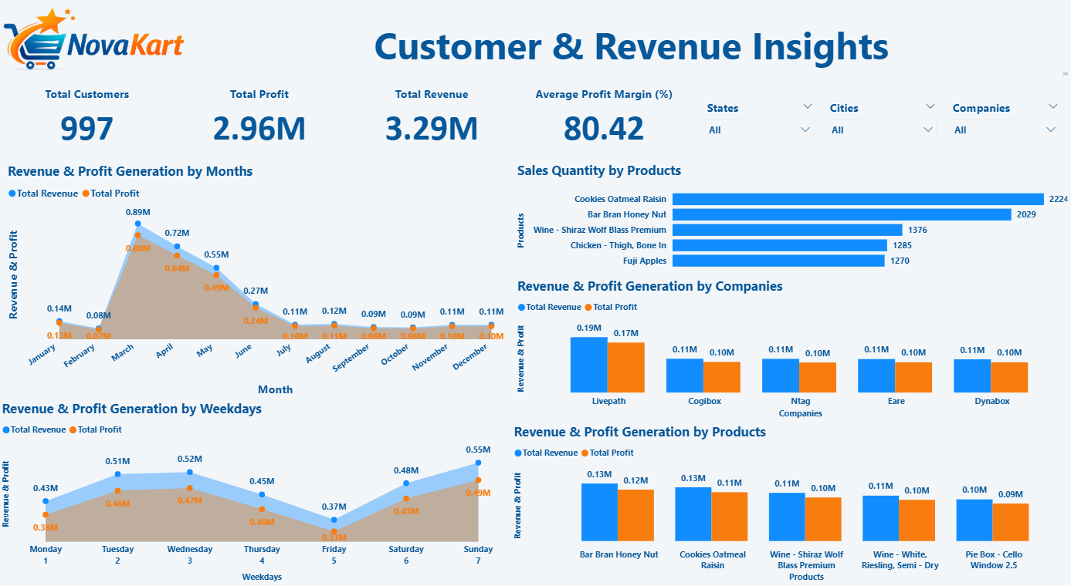
🖥️ Dashboard Overview (2) – Product & Company Insights

Slide 12
✅ Business Impact & Use Cases
Helps management identify high-value customers. Enables leadership to recognize customers contributing the highest revenue and profit, supporting targeted retention, personalized offers, and loyalty initiatives.
Enables region-wise strategy optimization. Provides clear visibility into state- and city-level performance, helping decision-makers prioritize high-performing regions and improve strategies in underperforming locations.
Supports product & vendor performance evaluation. Assists in identifying top-selling and most profitable products and companies, enabling informed decisions around inventory planning, vendor partnerships, and portfolio optimization.
Assists in seasonal demand forecasting. Reveals month-wise and weekday-wise sales patterns, helping businesses anticipate demand fluctuations, plan promotions, and allocate resources effectively.
Can be extended for pricing, discount & loyalty analysis. The analytical framework can be scaled to evaluate pricing strategies, discount effectiveness, and customer loyalty programs for future business growth.

Slide 13
🙏 Acknowledgement & Contact
Project Analyst: Anik Chakraborty 📧 Email: anikc1710@gmail.com
Special Thanks To:
Coding Ninjas – for project framework and guidance
Connect: 🔗 GitHub | 🔗 LinkedIn

Slide 14
Thank You!

